Slide 1
Software Engineering
Lesson 2 – Introduction to Software Engineering

Slide 2

Lesson Content
What is Software Engineering?
Why is it important?
Costs of Software Engineering
Areas and Scope of Software Engineering
4 Ps of Software Engineering

Slide 3

Brain Storimg Session
Write down the first thing that comes to mind when you hear the word
Software Engineering

Slide 4

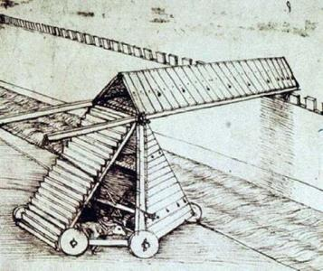
What is Engineering ?
Engineering is
the discipline, art and profession of
acquiring and applying technical, scientific and mathematical knowledge
to design and implement materials, structures, machines, devices, systems, and processes
Leonardo da Vinci - a painter, sculptor, architect, engineer, and scientist.
His scientific studies - particularly in the fields of anatomy, optics, and hydraulics - anticipated many of the developments of modern science.

Slide 5

Definition
Software engineering is a profession and a field of study dedicated to creating software of higher quality, more affordable and maintainable, quicker to build.
It covers techniques and procedures, often regulated by a software development process, focused on how to improve the reliability and maintainability of software systems.
Goal of SE:
To produce software on time and to the budget that satisfies the requirements of the users in a changing environment

Slide 6

How many projects deliver good systems?
Nowadays software products are becoming more and more complex
From IEEE Spectrum Article “Why Software Fails” By Robert N. Charette
Of the IT projects that are initiated, from 5 to 15 percent will be abandoned before or shortly after delivery as hopelessly inadequate.
Many others will arrive late and over budget or require massive reworking.
Few IT projects, in other words, truly succeed.

Slide 7
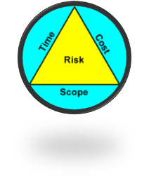
Why Software Engineering is important?
Same questions have been asked for many years now:
Why does it take so long to get software finished?
Why are development costs so high?
Why cant we find the errors before we give the software to clients?
Why do we continue to have difficulty in measuring progress as software being developed?

Slide 8
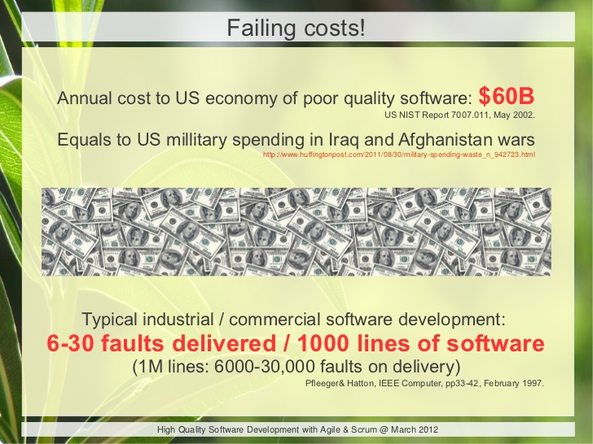
Costs of Software engineering
The economies of ALL developed nations are dependent on software
More and more systems are software controlled
Producing and maintaining high quality systems cost effectively is essential for the economy
Expenditure on software represents a significant fraction of GNP in all developed countries

Slide 9
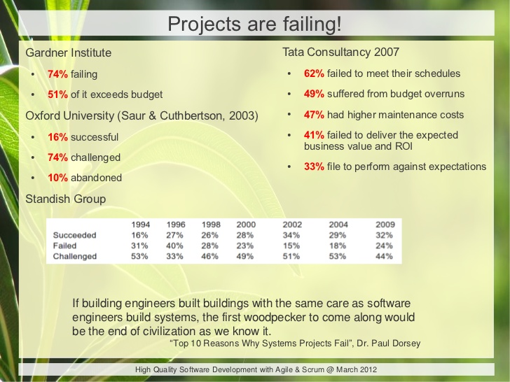
Some Statistics

Slide 10
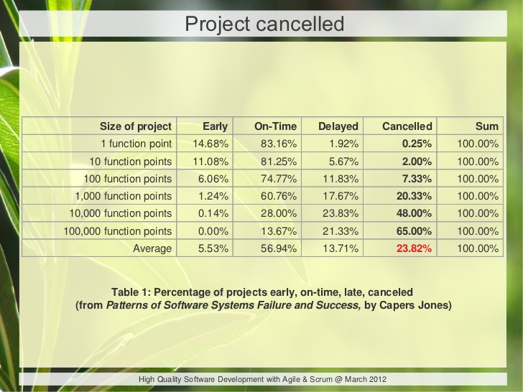
More Statistics

Slide 11
Classic Cases of Failed Projects
Case | Effect | Cost | Cause
Mars Climate Orbiter | Space Craft Exploded after entering Mar’s Orbit at the wrong angle | $327.6 million | Different Units of Measure! One group working on the thrusters measured in English units of pounds-force seconds; the others used metric Newton-seconds! The thrusters were 4.45 times more powerful than they should have been.
Therac-25 radiation therapy | In six documented cases, megavolt X-rays were sent, unfiltered and unshielded, toward patients requiring therapy. | Radiation poisoning, which claimed several lives | Reusing code on a new system without thorough testing. Previous versions on Therac did not have this problem but hardware constraints prevented older machines from delivering high radiation amounts. In the new system, these constraints were removed, codes were cryptic, undocumented and easily overridden by untrained staff.
Notes:
http://www.computerworld.com/article/2515483/enterprise-applications/epic-failures--11-infamous-software-bugs.html

Slide 12
Classic Cases of Failed Projects
Case | Effect | Cost | Cause
FBI Virtual Case | Project delivered was so bug ridden and useless that it had to be scrapped | An Additional $123.2 million for the project | Poorly defined design requirements, an overly ambitious schedule and the lack of an overall plan
Denver International Airport Automated Baggage-Handling System | System was not completed on time and delayed the opening of the largest airport in the US and when completed did not work properly! | Financial Impacts due to Delay. Chewed up and/or derailed baggage. Law suit by Airlines | State and local political leaders held the project to one unrealistic schedule after another.
Notes:
http://www.computerworld.com/article/2533563/it-project-management/it-s-biggest-project-failures----and-what-we-can-learn-from-them.html
http://spectrum.ieee.org/computing/software/why-software-fails

Slide 13
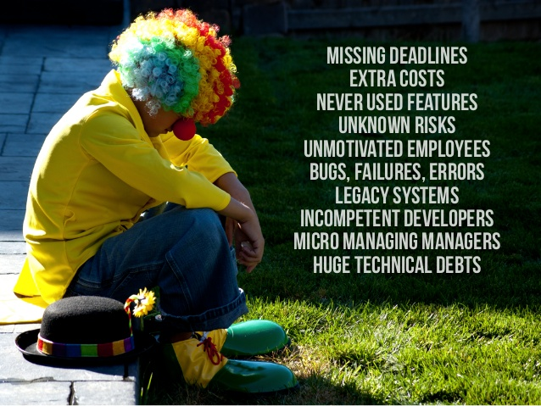
Software costs
Software costs often dominate computer system costs.
The costs of software on a PC are often greater than the hardware cost
It costs more to maintain than it does to develop software.
For systems with a long life, maintenance costs may be several times development costs
Software engineering is concerned with cost-effective software development

Slide 14
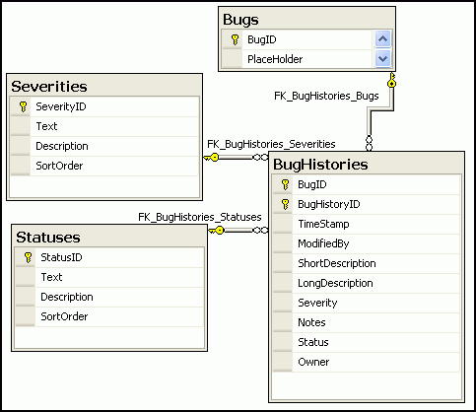
Areas and scope of SE
Software Engineering is made up of various knowledge areas, namely:
Software Requirements/Software Analysis
The activity of obtaining, analysing, and recording requirements for software systems
Software Design
The activity in which software requirements are analysed in order to produce a description of the software’s internal structure that will serve as the basis for its construction

Slide 15

Areas and scope of SE cont...
Software Construction
The detailed creation of working, meaningful software through a combination of coding, verification, unit testing, integration testing and debugging
Software Testing
This consists of the dynamic verification of the behaviour of a program on a finite set of test cases, suitably selected from the usually infinite executions domain, against the expected behaviour

Slide 16

Areas and scope of SE cont...
Software Maintenance
The totality of activities required to provide cost-effective support to software.
Software Configuration Management
The discipline of identifying the configuration of a system at distinct points in time for the purpose of systematically controlling changes to the configuration, and maintaining the integrity and traceability of the configuration throughout the system lifecycle.

Slide 17
Areas and scope of SE cont...
Software Management
The application of management activities – planning, coordinating, measuring, monitoring, controlling and reporting – to ensure that the development of software is systematic, disciplined, and quantified
Software Process
This area concerns knowledge about commonly used software life-cycle process models, e.g. agile, waterfall, spiral, etc..

Slide 18

Areas and scope of SE cont...
Software Engineering Tools & Methods
Tools allow repetitive, well-defined actions to be automated, reducing the cognitive load on the software engineer who is then free to concentrate on the creative aspects of the process
Software Quality Assurance
The process that helps ensure that characteristics fulfil the requirements

Slide 19

The 4 Ps of Software Engineering
SE focuses on 4Ps :
Processes
People
Practices
Paradigms

Slide 20
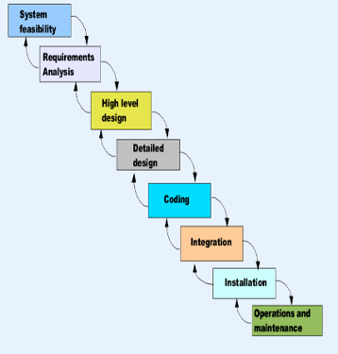
1 Process
What?
When building a software, it’s important to go through a number of defined stages (a roadmap) which helps to build a reliable, good quality product. This roadmap is called software process
Who?
Managers choose appropriate process for a specific type of projects and follow it
Why?
It provides clarity and makes control and management easier to perform

Slide 21
1 Process cont..
What are the steps?
Depend on the project and model you chose for it
Personal webpage vs. Life support system
Traditionally process consists of 6 phases:
Planning and Feasibility study
Analysis
Design
Development (Coding)
Testing
Operation & Maintenance
Notes:
Somerville defines 4 main stages:
Software specification - The functionality of the software and constraints on its operation must be defined (Planning and Analysis)
Software development -The software to meet the specification must be produced (Design and Coding)
Software validation - The software must be validated to ensure that it does what the customer wants (Testing)
Software evolution - The software must evolve to meet customer needs (Operation and Maintenance)

Slide 22

2 People
Different types of people are involved in software engineering project:
Software engineers (developers) – they undertake the work to develop systems
Users - persons who in some way interact with the final system
Customers take decision about the software’s design (often users themselves)

Slide 23

3 Practices
Practices are the specific activities a software engineer undertakes in order to develop a system,
Example: to gather requirements from a user one can use:
Interviews
Questionnaires
Observation
Learning business documents
Joint Application Development

Slide 24
4 Paradigm
Paradigm is a set of practices which are linked together around a set of beliefs about the way we should develop software.
e.g.
Object oriented approach considers the world as a set of interacting objects
Structured systems analysis approach considers the world as functions operating on data structures

Slide 25
Further Reading
Forum On Risks To The Public In Computers And Related Systems http://catless.ncl.ac.uk/Risks/index.28.html
The worst IT project disasters of 2013 http://www.itworld.com/article/2830840/enterprise-software/the-worst-it-project-disasters-of-2013.html
10 worst ever government IT projects http://www.computing.co.uk/ctg/feature/2422715/the-10-worst-ever-government-it-projects/page/2

Slide 26
Group Activity
Software Disasters PowerPoint Presentation
Deliver a 10 minute presentation about one of the worst IT project disasters in the past years.
What was the system, who developed it and when.
What Happened? A brief description of how and why the project went wrong
Ingredients for Failure: What were the reasons that caused this disaster?
What, in your opinion, could have been done to prevent this disaster
Notes:
Classic cases
Ariane 5 Launcher
FBI virtual case File
Taurus Stock exchange system
Denver Airport Luggage Handling System
London ambulance
Therac-25 radiation therapy

Slide 27

End of Lesson 2
Any questions?

